Slide 1
Positron Experiments at Jlab and ALLS
Paul Guèye
Hampton University

Slide 2
Outline
Some brief review of nuclear physics
Multi-photons
Role in scattering amplitude
e⁺/e⁻ physics
Polarized positrons at Jlab: PEPPo experiment
Positrons production at ALLS

Slide 3
Nuclear Physics
From molecules, atoms to nuclei
Same processes, different scale!
Nuclear physics
Cleanest tool: electromagnetic (e±,γ)

Slide 4
e⁻ Scattering - 1
Framework of the Plane Wave Born Approximation
Scattering amplitude: expansion in (αZ)^{n}
Dominant diagram: 1γ exchange (α = 1/137)

Slide 5
e⁻ Scattering - 2
PWBA/Partial wave/DWBA
Phase shift analysis
If not too many partial waves
Optical potential: scattering of waves
Ψ_{i} (φ)➔Ψ_{f}(φ’): δφ is due to scattering
Distorted Wave Born Approximation (DWBA)
Distortion of the plane due to Coulomb force
Effective Momentum Approximation (EMA)

Slide 6
e⁻ Scattering - 2
E_{Beam} | Nucleus | Coulomb Field V_{C}(r=0) | V_{C}/E_{Beam} | Comments
100 MeV | 12C | 5 MeV | 5% | Important
 | ²⁰⁸Pb | 25 MeV | 25% | Very important
500 MeV | 12C | 5 MeV | 1% | Some what important
 | ²⁰⁸Pb | 25 MeV | 5% | Important
1 GeV | 12C | 5 MeV | 0.5% | Small (neglect)
 | ²⁰⁸Pb | 25 MeV | 2.5% | Relatively small
A. Aste (2005), arXiv:nucl-th/0502074v3

Slide 7
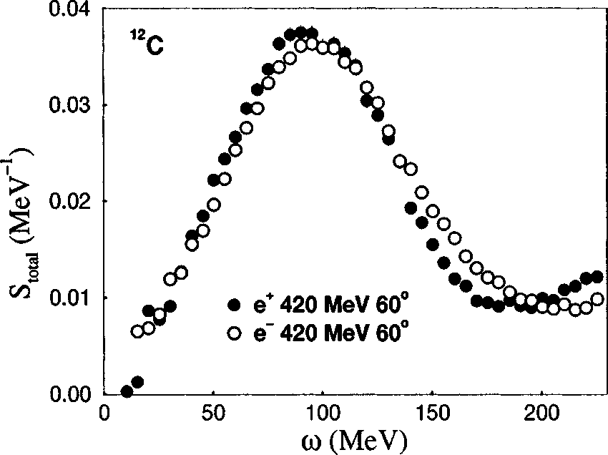
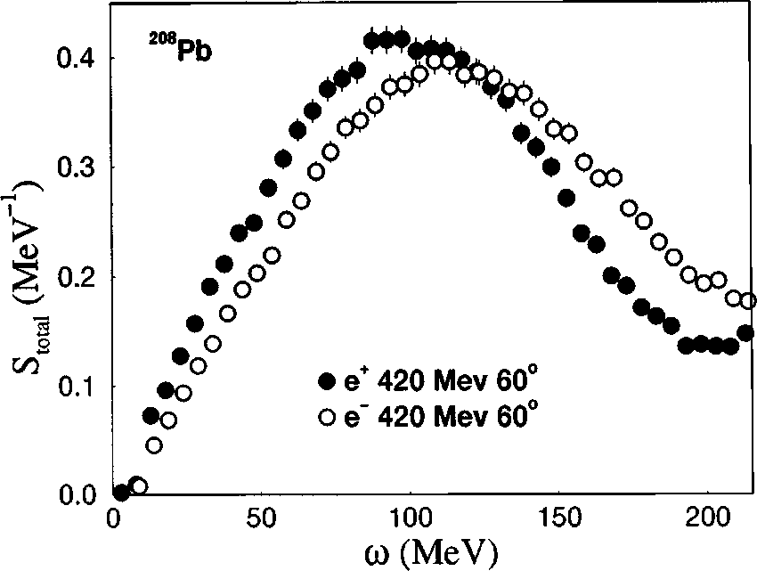
Jlab and 2γ Exchange Issues - 1
Dominant at low-Q²
P. Guèye et al., Phys. Rev. C60, 044308 (1999)
Quasi-elastic Peak

Slide 8
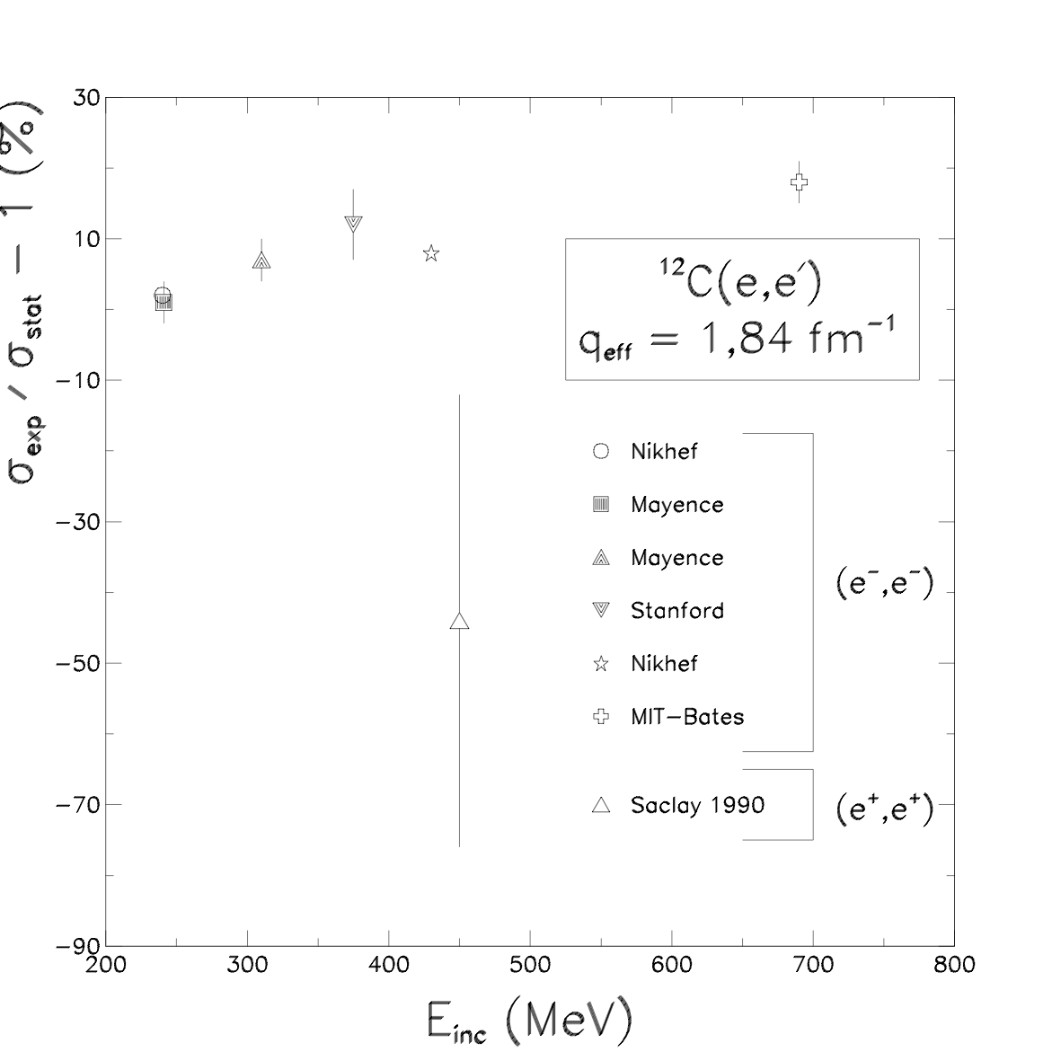
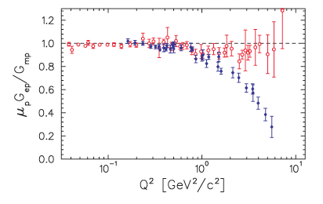
Jlab and 2γ Exchange Issues
Is it really?
P. A. M. Guichon, and M. Vanderhaeghen, Phys. Rev. Lett. 91, 142303 (2003)
[M. Khol, Previous talk]
Elastic Peak
J. Arrington, Phys. Rev., C68, 034325 (2003)
P. Guèye et al., Phys. rev, C57, 2107 (1998)

Slide 9
Timeline - 0
< 1999
Low energy positron beams with CW machine
Discussions between Jlab staff and physicists
Materials science (W. Kossler)

Slide 10
Timeline - 1
1999 @ Jlab
Mini-workshop on e⁺/e⁻ Physics at Jefferson Lab
½ day (13:00-17:00)
17 participants
Speakers
P. Guèye*: dispersive effects [elastic] & EMA [quasi-elastic]
J.-M. Laget: e+e→γγ, 2γ in D₂ form factor, VCS
C. Hyde-Wright: hadronic radiative corrections (e+p → e+n+π⁺+γ), DVCS, weak interaction, materials sciences
V. Lebedev: accelerator parameters (new 50 MeV e⁺ linac, e⁻ beam (500 MeV, 1 mA, 0.5 MW beam dump), e⁺ (10 μA)
Cost estimate: $5M

Slide 11
Timeline – 2/a
2000
Letter-Of-Intent (LOI) generated for PAC
Physics (most already discussed at JPOS09!)
Nuclear: DVCS, Dispersive effects, radiative corrections, D₂ form factor, fractionally charged partons [sum rule: deep inelastic Bremsstrahlung structure function V(x)], parity violating structure functions
High energy (upgrade): collider physics (ELIC, c/τ factory …)
Material: angular correlation of annihilation radiation (ACAR), defects characterization

Slide 12
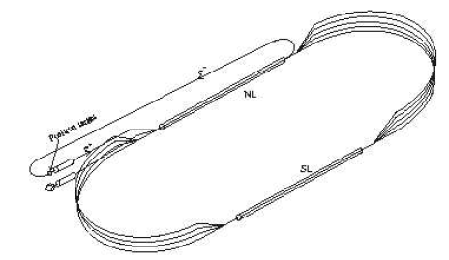
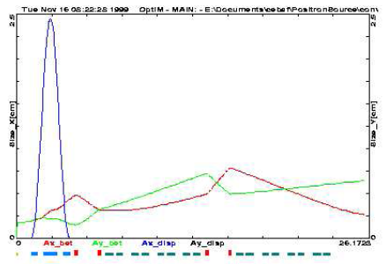
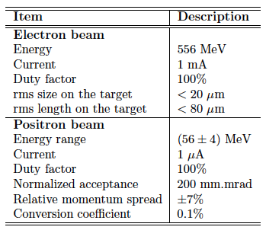
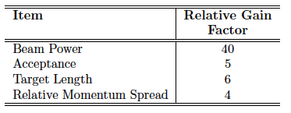
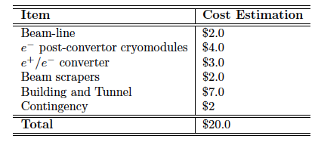
Timeline – 2/b

Slide 13
Timeline – 3
2004 @ Jlab
Micro-workshop on positron physics
10 participants
Co-Organizers: P. Guèye & J. Arrington
Beam requirements for physics at Jlab
Focus on 2γ exchange & EMA
Reactions: ep, eA, quasi-elastic, resonances, …
Physics: Coulomb distortions, dispersive effects, parity violation …

Slide 14
Timeline – 4
Jlab management
Focus on 12 GeV upgrade
Wait for LOI
Alternative?
Laser induced positron beam (US)
Accelerator induced positron beam (Africa)

Slide 15
Timeline – 5
2006 @ National Society of Black Physicists
NSBP annual meeting (San Jose, CA)
1st ultrafast laser applications and positron physics workshop
40 participants

Slide 16
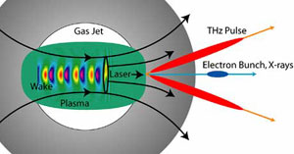
Facilities - 1
United States (GeV positron machine)
Laser based
Ultrafast, high power laser
GV/cm accelerating gradient!
R&D: worldwide (US – SLAC, UNL, UMich …), Japan (KEK …), Europe (LOA …) …
As injectors for conventional cavities
High energy e⁻ beam with ultrafast lasers
1997: E_{e} = 70 MeV, ΔE/E = 100%, every 10 mins, 3 TW!
2004: E_{e} = 200 MeV, ΔE/E = 3%, 10 Hz, 1 PW
2006: E_{e} = 1 GeV, ΔE/E ≈ 1%, 10 Hz, 30 TW (in 3.3 cm!)
Q/pulse ≈ pC
Technological development
2007: 200 TW are commercially available
2008: 500 TW are commercially available
2008: 10 Hz -> 100 Hz for TW lasers
Relevant laser parameters
10-400 fs pulse
mJ-few Joules
Microns spot size
W.P. Leemans, B. Nagler, A.J. Gonsalves, Cs. Toth, K. Nakamura, C.G.R. Geddes, E. Esarey, C.B. Schroeder, and S.M. Hooker, "GeV electron beams from a centimetre-scale accelerator," Nature Phys. 2, 696-699 (Oct 2006), LBNL-60105.

Slide 17
Facilities - 2
Africa (up to 100s MeV machine)
Accelerator based
Conventional 10-50 MeV injector/Energy recovery scheme(?)
Radiator for pair production
Pulsed beam (50 Hz)
Phase 1
Low energy physics & applications
Benchmarking for simulation (Geant4 …)
Research & education
Phase 2
Upgrade to 100s MeV

Slide 18
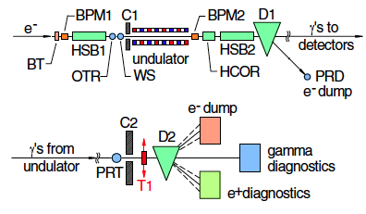
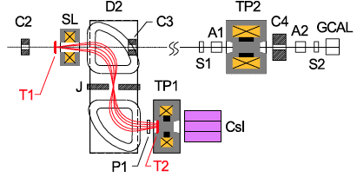
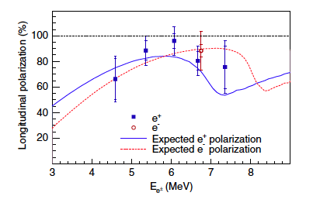
Positrons at Jlab - 1
SLAC/E166 Experiment (2005)
46.6 GeV e⁻ beam
Rep: 10 Hz
N_{e} = 1-4x10⁹ e⁻/pulse
Emittance: 2.2x10⁻⁵ m.rad
Use of an undulator:
Photons through Bremsstrahlung
Circularly polarized photons
Max energy: ~8 MeV

Slide 19
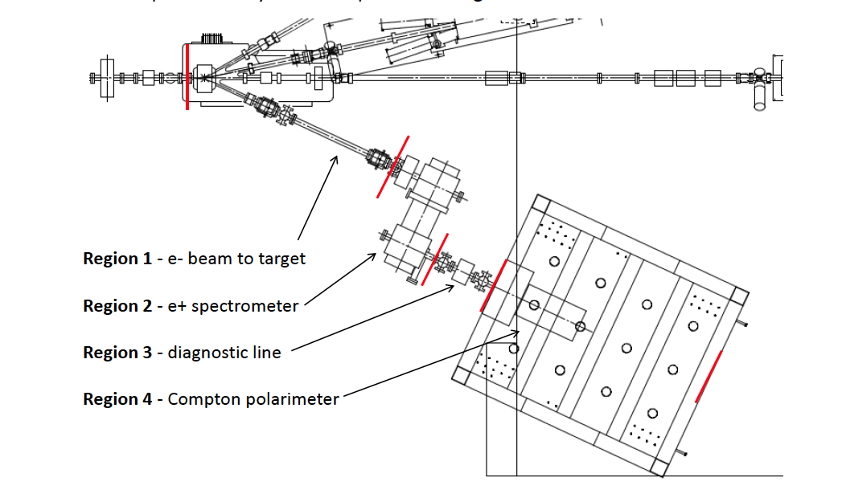
Positrons at JLab - 2
Accelerator/Nuclear Physics Collaboration
First “user” –like experiment in the injector

Slide 20
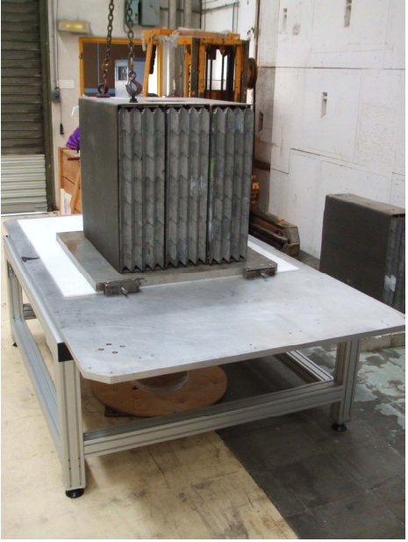
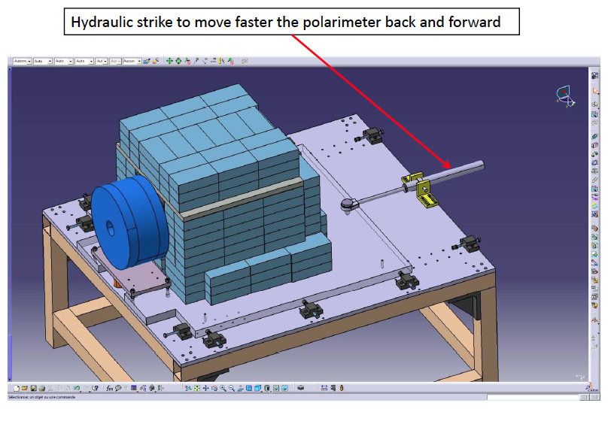
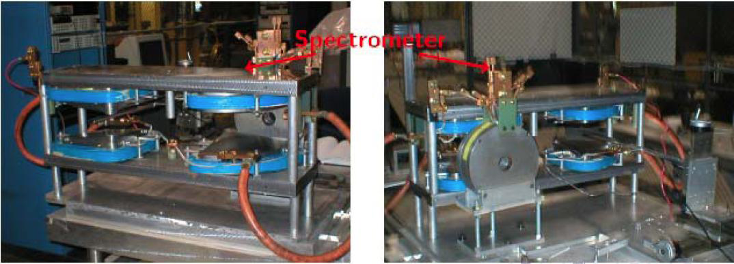
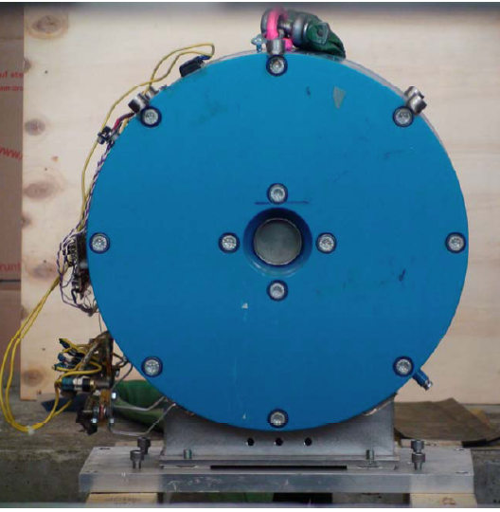
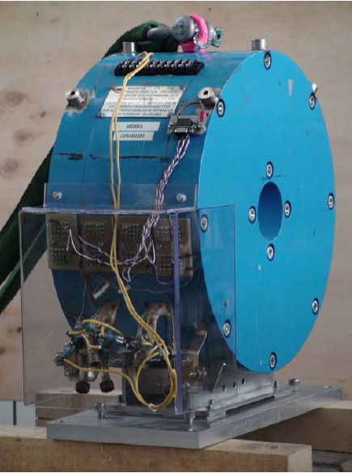
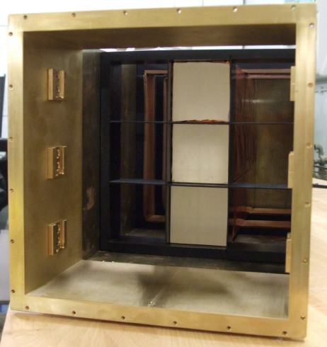
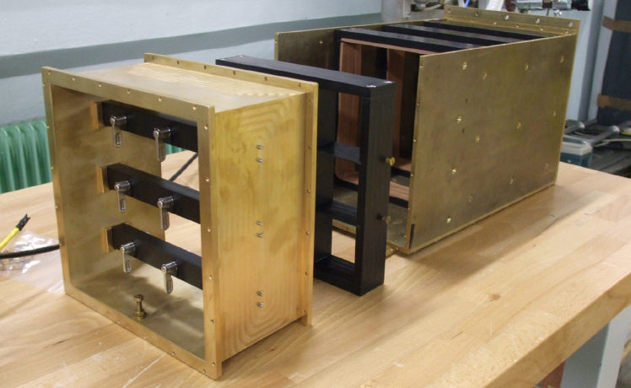
Positrons at Jlab - 3
Polarized Electron for Polarized Positrons (PEPPo)
Refurbish E166 Experiment
Spectrometer, calorimeter …

Slide 21
Positrons at Jlab - 4
PAC35-LOI
Very favorable review
Full support from the Lab
Timeline:
Summer 2011: installation
Fall 2011: commissioning and test data
PAC37-Proposal
For dedicated time in Spring 2012
To be submitted this summer

Slide 22
Geant4 Simulation
1k gammas
10k electrons
100k positrons
HU responsibility:
Geant4 & beamline diagnostics

Slide 23
ALLS Facility

Slide 24
Positrons at ALLS
Collaboration
Institut National de la Recherche Scientific and Advanced Laser Light Source
Advanced Laser Light Source
Argonne National Laboratory
Department of Homeland Security
Yerevan Physics Institute
Jefferson Lab
University Cheikh Anta Diop
Axis Photonique
Lintech Inc.
Tech-X Corp.
2010 Proposal: NSF/DOE Partnership in Basic Plasma Science and Engineering
Ongoing experiments on electron acceleration. Plan for small positron tests late 2011/2012

